Slide 1
Public Transport Route Finder
25A31A05DA | KUPPILI VENKATA NOOKA SURYA KIRAN
25A31A05BL | DOMMETI SNEHITHA
25A31A05DM | PYLA DHARMIC NAGA ANJANA KUMAR
25A31A05CF | PRAGALLAPATI SATYA SREE
Branch & Year-I CSE C
College Name: PEC (A) Surampalem

Slide 2
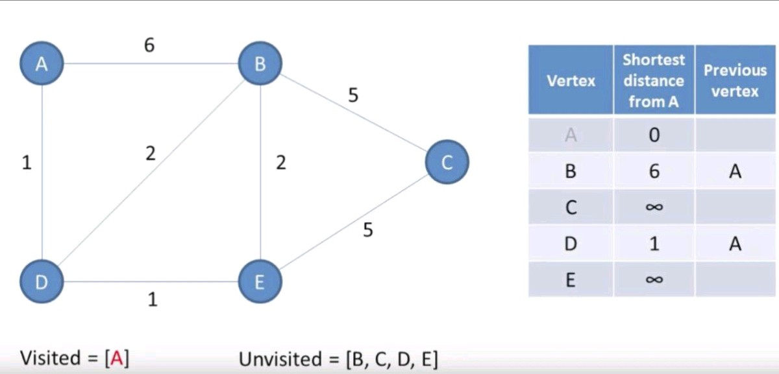
Objective of the Project
To find the shortest route between two stations
To apply graph concepts to a real-world problem
To implement Dijkstra’s and A* algorithms in C++
To reduce time and effort in route selection
To understand how pathfinding works in navigation systems

Slide 3
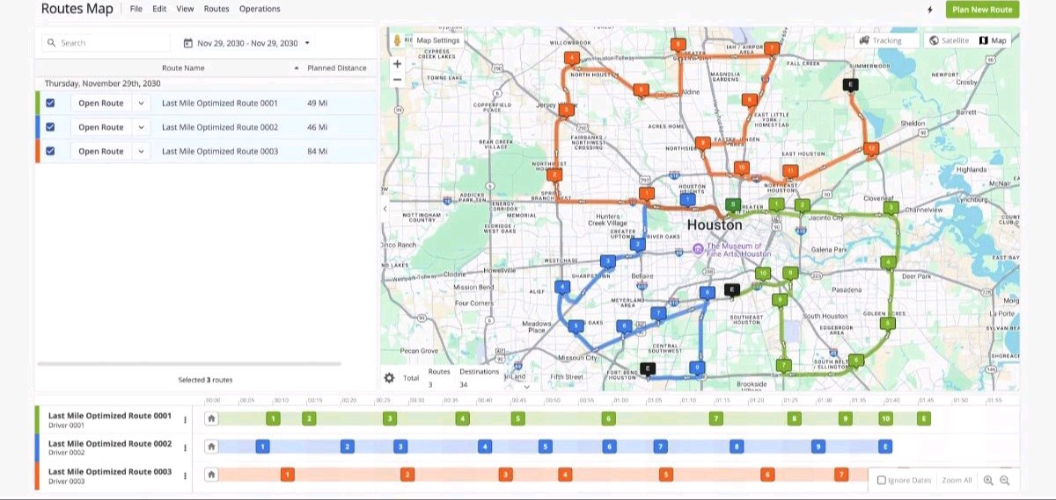
Problem Statement
🔴 Limitations of Existing System
Manual route selection is inefficient
Difficult to find shortest path in large networks
Time-consuming and error-prone
No optimized way to compare multiple routes

Slide 4
THANK YOU

